Slide 1
Bank Risk Controller System: Predicting Loan Defaulters
A Classification Machine Learning Project
Name : Vasanth ram . S
Batch : MDTM28
Date: October 15, 2025

Slide 2
Project Overview
Core Problem: Predict whether a customer will get a default or not.
Objective:
To develop a robust and interactive data-driven solution for predicting loan default risks, leveraging advanced machine learning models and exploratory data analysis, while integrating a user-friendly Streamlit application for real-time insights and decision-making.

Slide 3
Dataset overview
Data Source: “Loan_data.csv” and “Data_dictionary.csv”. The dataset contains historical loan application data, including personal details and loan status.
With the help of it we used to predict the likelihood of loan default (binary classification: 0 for non-defaulters, 1 for defaulters).
It is an imbalance dataset, TARGET is mostly manipulated with non-defaulters, defaulters are 1/10 of the portion.

Slide 4
Data cleaning and preprocessing
High Null columns: There are few columns with large amount of null values, those columns are removed.
Firstly Object columns are treated with mode.
Numeric columns have been treated with median and mode.
Feature Reduction: we used multiple techniques to understand the importance of the feature to the prediction
Such as Chi2 test, Mutual info score and Feature important score from RandomForest model.
Finally with some domain knowledge and union of all techniques, we selected most important columns for the prediction.

Slide 5
Exploratory Data Analysis (EDA)
Performed extensive EDA to understand distributions and relationships.
Feature engineered few columns like age category, income category, income credit ratio etc..
Outlier deduction, some of columns have outliers like “employed years” having 100+years , those outlier are removed with IQR method.
Data Visualization like :
Target distribution , categorical feature influence in target, gender distribution on target , relation b/w loan amount and income , age distribution by target ect…
Box plot for outliers , histogram with kde for data distribution, correlation heat map etc…
Label encoder and Ordinal encoders are used for categorical encoding

Slide 6
Model building
Cleaned encoded data separated as values and target.
Due to the imbalance in target variable we used SMOTE (synthetic minority oversampling technique) to ensure both the classes are in the equal amounts.
Train test split done in resampled data , with 80% for training and 20% for testing.
All metrics and confusion matrix are made as user defined function for convenience.
Model training started with basic model and moved on to the advanced algorithms like bagging & boosting.

Slide 7
Machine Learning Models
Models Used:
Logistic Regression
Decision Tree
Random Forest
Gradient Boosting (XGBoost, CatBoost)
Performance Metrics:
Accuracy, Precision, Recall, F1-Score, ROC-AUC.
Best Model: Random Forest with 96% above in all metrics.

Slide 8
Model Performances
Models | Accuracy | Precision | Recall | F1-Score | ROC-AUC
Logistic Regression | 56.86 | 56.69 | 58.53 | 57.59 | 59.12
Decision Tree | 93.33 | 92.58 | 94.22 | 93.39 | 93.33
Random Forest | 96.78 | 96.80 | 96.77 | 96.78 | 99.61
Extended Gradient Boost | 75.93 | 76.23 | 75.44 | 75.83 | 76.64

Slide 9
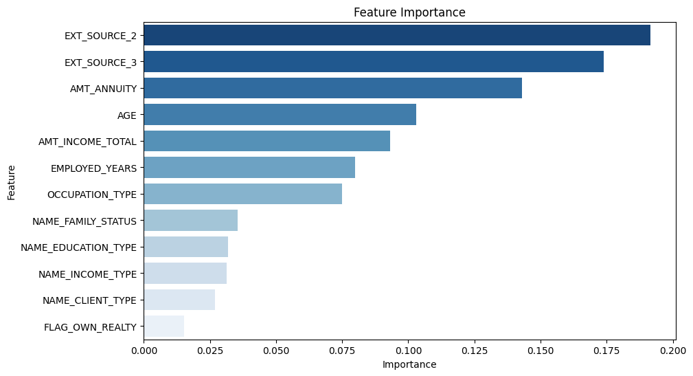
Important Features

Slide 10
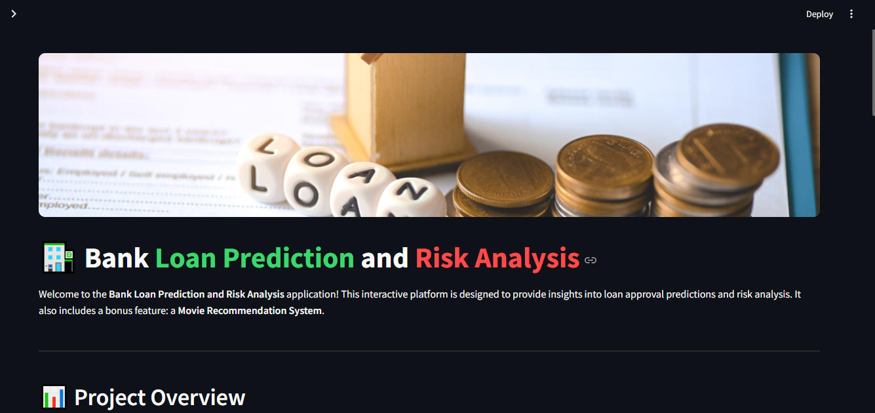
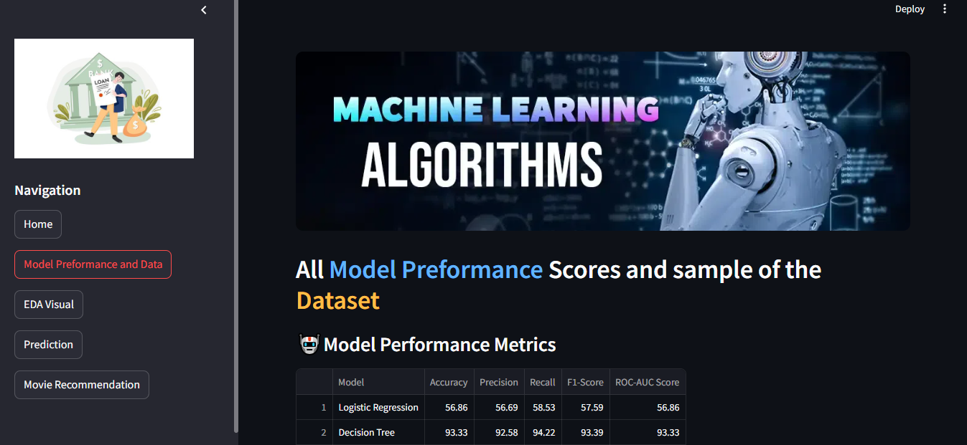
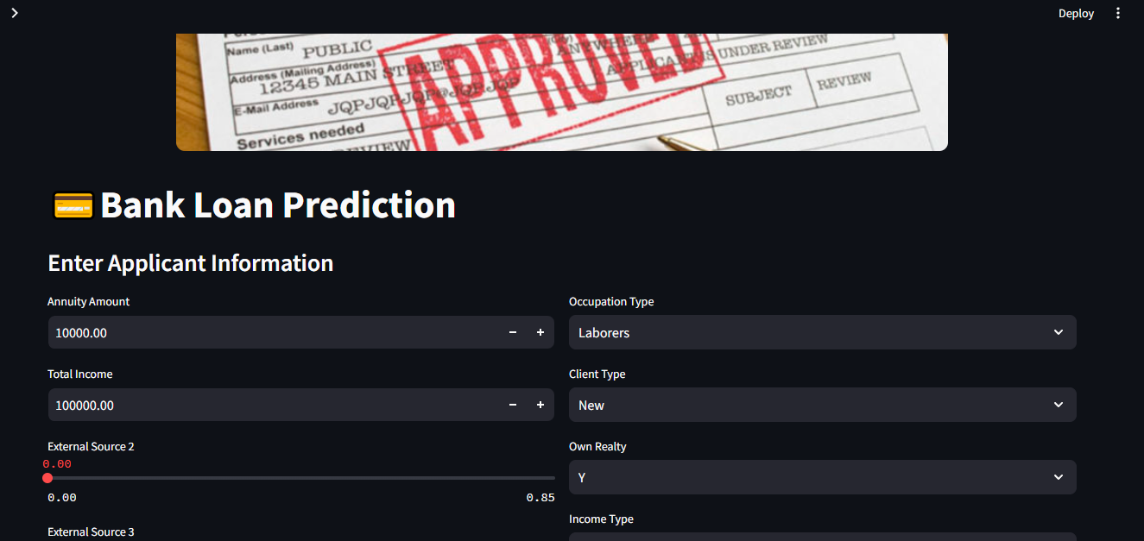
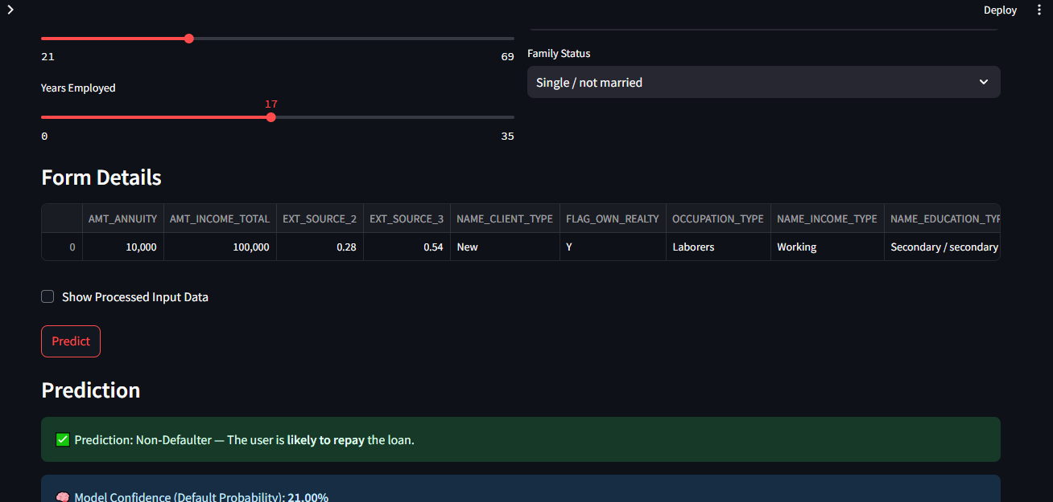
Streamlit - bank app

Slide 11
Movie Recommendation System
Provide personalized movie suggestions based on user preferences.
Technique Used: Content-based filtering.
Algorithm: TF-IDF (Term Frequency-Inverse Document Frequency) vectorization combined with Cosine Similarity.
Data Source: Two Movie dataset - Movies and Credits Are downloaded from Kaggle.
Implementation Steps :
Preprocessing : Cleaned and tokenized movie descriptions and Combined relevant features (e.g., genres, keywords) into a single text field.
Vectorization : Converted text data into numerical vectors to represent the importance of terms.
Cosine Similarity : Measured the similarity between movies based on their vectorized representations.
Recommendation Logic: For a given movie, identified the top N most similar movies using similarity scores.

Slide 12
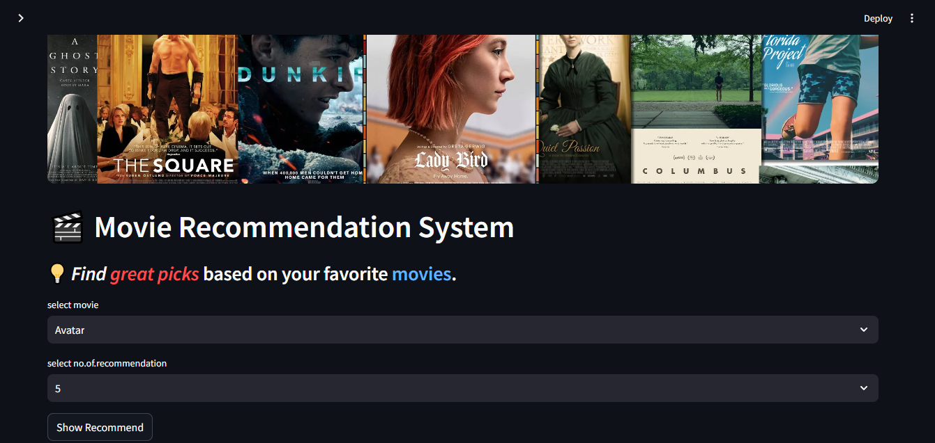
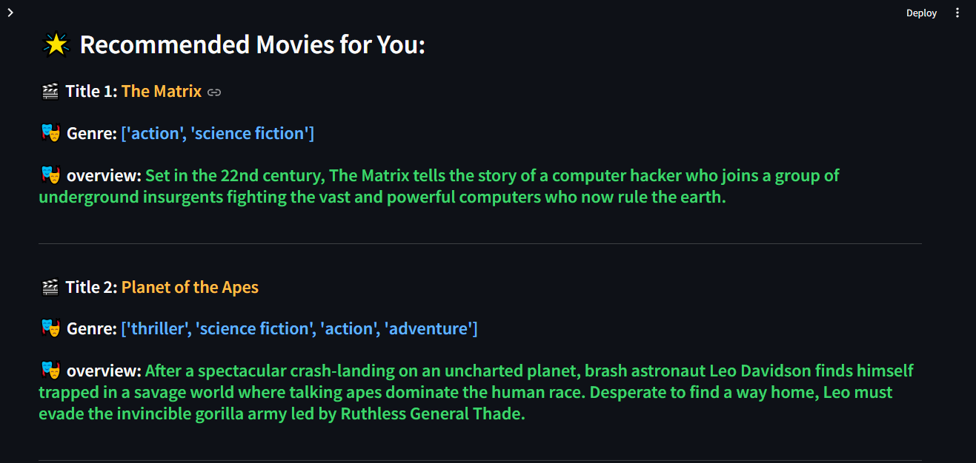
Movie Recommendation app

Slide 13
Technologies Used
Programming Language: Python
Libraries:
Data Analysis: Pandas, NumPy
Visualization: Matplotlib, Seaborn, Plotly
Machine Learning: Scikit-learn, XGBoost, CatBoost
App Development: Streamlit
Other Tools: Pickle

Slide 14
Conclusion
Built a robust system for loan prediction and risk analysis.
Integrated EDA, machine learning, and a simple recommendation system.
The project is also deployed as application, making it ready for real-world use.

Slide 15
Happy to discuss more in the Q&A. Thank you

